Slide 1
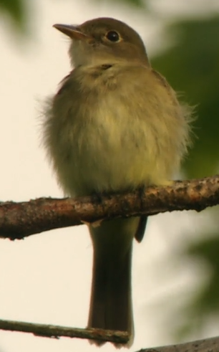
Aldfly: Alder Flycatcher
One song and 3 calls
Males sing a burry rreeee-BEEP or free-beer!, reminiscent of but thinner than an Eastern Phoebe’s song.
CALLS
The primary contact call is a low, flat pip.
https://www.allaboutbirds.org/guide/Alder_Flycatcher/sounds

Slide 2
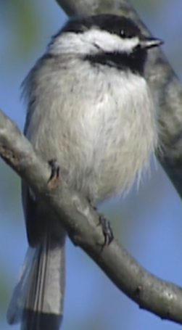
Bkcchi: Black-capped Chickadee
One song and 4+ calls
SONGS In most of North America, the song is a simple, pure 2 or 3-note whistled fee-bee or hey, sweetie. In the Pacific Northwest, the song is 3 or 4 notes on the same pitch; the song is also different on Martha's Vineyard in MA. In much of the range, males begin singing in mid-January, and the song increases in frequency as winter progresses. Females also sing occasionally.
CALLS Chickadees make their chickadee-dee-dee call using increasing numbers of dee notes when they are alarmed. They also have a gargling call, often given aggressively when a lower-ranking bird gets close to a higher-ranking one; also exchanged between members of a pair. Black-capped Chickadees make a high pitched see as a high-intensity alarm call, often when a fast-approaching predator is detected. When chickadees hear this call, they freeze in position until they hear a chickadee-dee call signifying “all clear.” High see calls most often given by males.
OTHER SOUNDS Chickadee nestlings make an explosive hiss and slap the inside of their nest cavity when an intruder looks in.
https://www.allaboutbirds.org/guide/Black-capped_Chickadee/sounds

Slide 3
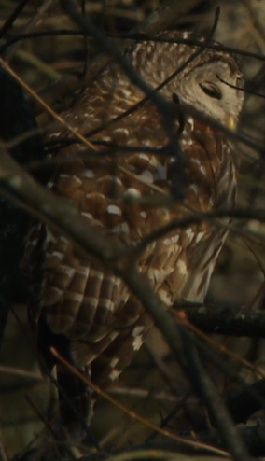
Brdowl: Barred Owl
2 subtypes, 10+ different sounds
SONGS Although the Barred Owl is not technically a songbird, its distinctive "Who cooks for you?" call (see below) functions as a song.
CALLS Barred Owls have a distinctive hooting call of 8–9 notes, described as “Who cooks for you? Who cooks for you-all?” This call carries well through the woods and is fairly easy to imitate. During courtship, mated pairs perform a riotous duet of cackles, hoots, caws and gurgles.
OTHER SOUNDS Both adults and young may snap their bills during squabbles.
https://www.allaboutbirds.org/guide/Barred_Owl/sounds

Slide 4
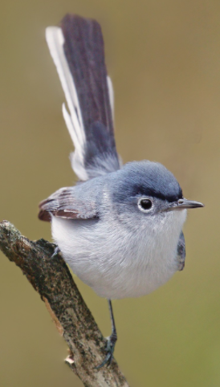
BUGGNA: Blue-Grey Gnatcatcher

Slide 5
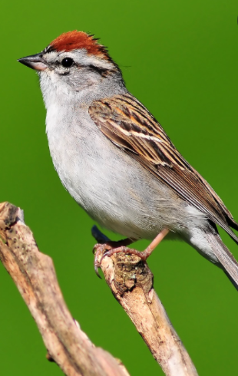
CHISPA: Chipping Sparrow
One song, two calls
SONGS Males sing a sharp, quick chibit often followed by a higher-pitched, rising tweet. The use of these elements varies, with some (especially the chibit) repeated in quick sequences. Males also perform a flight song, a rapid series of whit calls notes followed by a jumble of other call types.
CALLS Both sexes give a loud whit call note.
OTHER SOUNDS Bill snapping serves as a threat display and is occasionally heard when birds capture an insect.
https://www.allaboutbirds.org/guide/Gray_Flycatcher/sounds

Slide 6
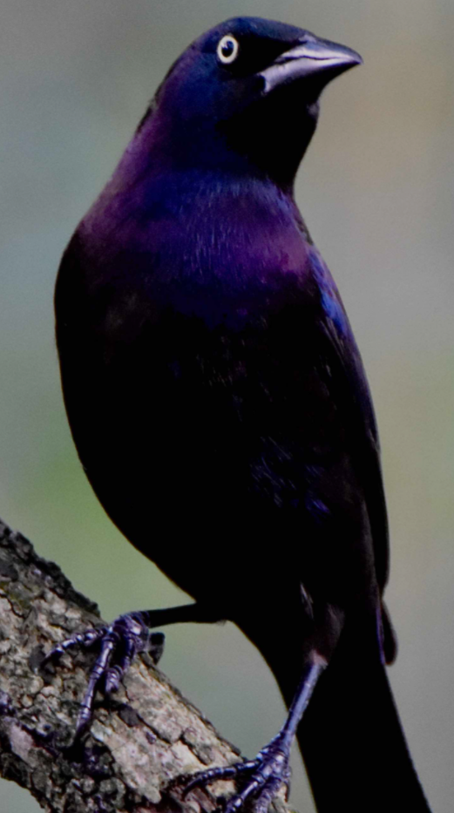
COMGRA: Common Grackle
3 Songs, 2 calls
SONGS In spring and summer, males sing a rich, liquid series of notes all on the same pitch. It’s essentially a slow trill, given to attract mates and mark territory. On rare occasions in early spring, a male delivers a flight song composed of halting, jumbled notes followed by its typical trill. Individual sparrows show slight variations in their songs, and there are distinct regional differences among populations’ songs as well.
CALLS The most common call note is a rich, sweet, resonant seet, given by both sexes. Males in conflict with other males also utter low, buzzy call notes. Females flushed from the nest might give a series of stuttering chip notes, and pairs sometimes give quiet, sibilant contact calls when apart.
https://www.allaboutbirds.org/guide/Swamp_Sparrow/sounds

Slide 7
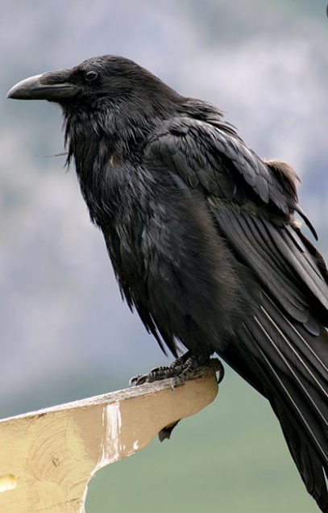
COMRAV: Northern Raven

Slide 8
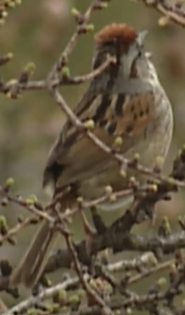
SWASPA: Swamp Sparrow

Slide 9
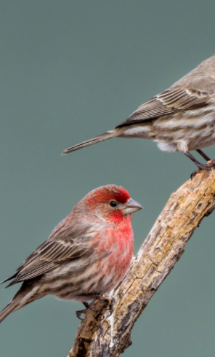
HOUFIN: House Finch

